Slide 1
LSTA Conference Measuring Success and the New SPR
LSTA Grants to States Conference
Philadelphia, PA March 2012

Slide 2

Overview of Presentation
Achievements to Date
Results Chain for Assessment
Building a Better Wheel (SPR)
Future Evaluations
http://www.flickr.com/photos/nosha/2930625287/

Slide 3
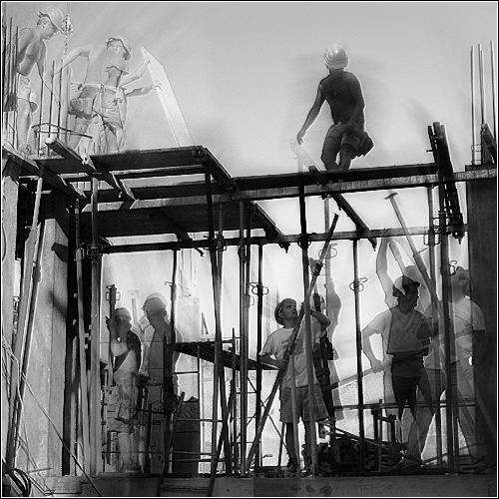
Developing a New Assessment Framework
Assessment questions by your peers are at the basis of the new SPR metrics
Simplify the current SPR
Review the materials with evaluation methodology experts
Review new SPR with COSLA, Measuring Success participants and other potential stakeholders
http://www.flickr.com/photos/jef_safi/324152992/sizes/o/in/photostream/

Slide 4
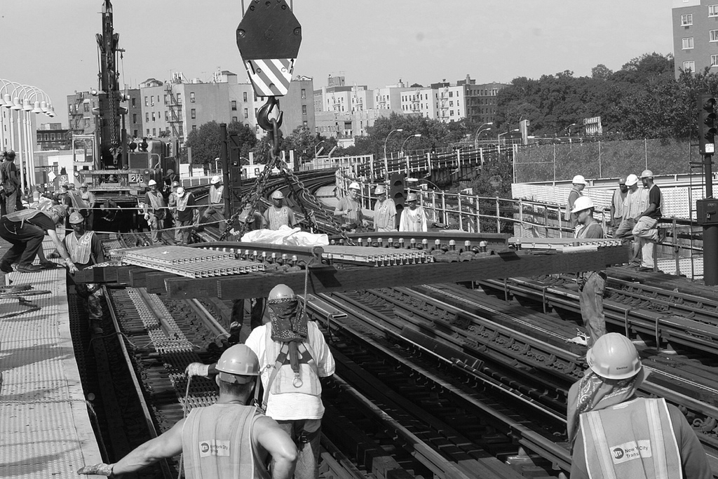
Operating Principles
Increase usefulness and rigor of evaluation tools
Focus on accountability to federal and state policy makers
Collect information to help SLAAs plan and manage programs and services
Respect state diversity in crafting services to address local needs
Do not stifle innovation
Ensure high level of SLAA engagement in the process
Streamline current reporting requirement
Improve performance measurement practice and reporting
http://www.flickr.com/photos/mtaphotos/5950443002/sizes/l/in/photostream/

Slide 5
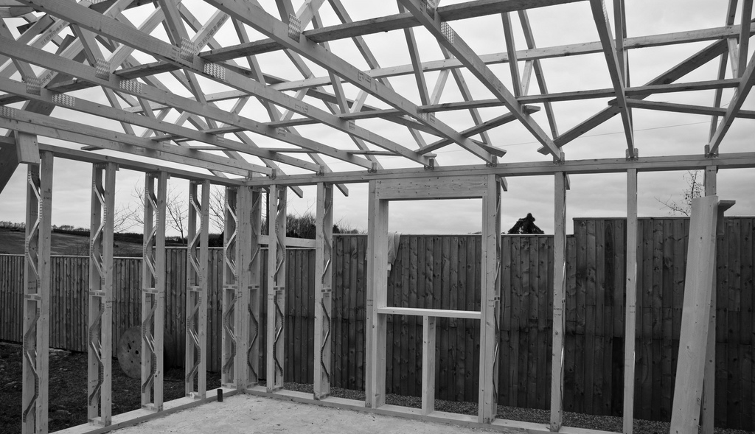
Progress Since Last LSTA Meeting
Summer webinars culminated in six broad categories (i.e. “results chains”) that SLAAs use in responding to public needs in their State with LSTA support.
This work is the basis of our framework and will guide performance assessment moving forward.
The groups also identified key actors, outcomes, and questions for assessment.
IMLS and SLAA partners focused on what needs to be assessed and what does not.
IMLS developing a framework for new SPR based on results chains, assessment questions and required data for program management and accountability.
http://www.flickr.com/photos/eandhbaxendale/4442971679/sizes/l/in/photostream/

Slide 6

What Measuring Success gave us…
Developed consistent logic models/theories of change that link the national legislation to the actual work of the states are engaged in.
Provides a clearer articulation of the mechanisms that result in public benefit.
Focusses IMLS’ performance reporting on themes the state partners felt were important/reflect their actual work.
http://www.flickr.com/photos/redbeansandrice/5818484603/sizes/l/in/photostream/

Slide 7
Focal Areas of LSTA Activities
Informal Education
Lifelong Learning
Human Services
Employment & Small Business Development
Information Access
Digitization
Electronic Databases
Civic Engagement
http://www.flickr.com/photos/redbeansandrice/5818484603/sizes/l/in/photostream/

Slide 8

Results Chains Detail
See results chains (11 x 17 sheets).
http://www.flickr.com/photos/intherough/3244476512/sizes/z/in/photostream/

Slide 9
Underlying Structure of Logic Models
SLAA Activity
Partner/ Grantee/Point of Service Activity
Beneficiary /User
http://www.flickr.com/photos/intherough/3244476512/sizes/z/in/photostream/

Slide 10
Capturing Action at the SLA Level
State Planning
State Level Partnerships
Staff Development
Information Resources
Standards
SLAA Activity
http://www.flickr.com/photos/intherough/3244476512/sizes/z/in/photostream/

Slide 11
Action at the Point of Service/Grantee/Partner Level
Marketing/ Recruitment
Local planning/ partnerships
Characterizing different service models.
Partner/ Grantee/Point of Service Activity
http://www.flickr.com/photos/intherough/3244476512/sizes/z/in/photostream/

Slide 12
Action at the Point of Service/Grantee/Partner Level
Did they get what they needed?
Did it make a difference?
Apply new skills?
Make more informed decisions?
Did they share info?
Beneficiary/User
Experience
http://www.flickr.com/photos/intherough/3244476512/sizes/z/in/photostream/

Slide 13
Model Reporting Hierarchy
Focal Area X
[SLA Activity]
[Project #1 Reporting]
[Project #1 User/Beneficiary Info]
[Project #2 Reporting]
[Project #2 User/Beneficiary Info]
http://www.flickr.com/photos/eandhbaxendale/4442971679/sizes/l/in/photostream/

Slide 14
SLA Activity Reporting
State level planning? Y/N
How much?
State level partnerships? Y/N
Which agencies/NGOs?
Staff Development provided for X Focal Area? Y/N
What type? How much?
Grant making/Funding? Y/N
Total expended for focal area?
http://www.flickr.com/photos/eandhbaxendale/4442971679/sizes/l/in/photostream/

Slide 15
SLA Activity Reporting
State level planning? Y/N
How much?
State level partnerships? Y/N
Which agencies/NGOs?
Staff Development provided for X Focal Area? Y/N
What type? How much?
Grant making/Funding? Y/N
Total expended for focal area?
http://www.flickr.com/photos/eandhbaxendale/4442971679/sizes/l/in/photostream/

Slide 16
Project Reporting
[Focal Area X Project #1 Info]
Program modality
How is it delivered? (e.g. on-site, off-site; with/without local partners; ;
Dosage
At what intensity? (e.g. contact hours per program)
Training provided
Training/capacity building given to local
Project dollars
Grant Amount?
Match?
Infrastructure/info resources provided
Technology or information resources used?
New resources procured/developed?
Total served?
[Focal Area X Project #2 Info]….
http://www.flickr.com/photos/eandhbaxendale/4442971679/sizes/l/in/photostream/

Slide 17
User Beneficiary Reporting
Participation rate/amount
Demographics
Satisfaction with program
Knowledge gain/other added value
Applied new skills and/or information
Used other local services
http://www.flickr.com/photos/eandhbaxendale/4442971679/sizes/l/in/photostream/

Slide 18

Putting It All Together
What will we get from all this?
Reporting Framework Based on the way in which you do business
More information about SLAA Level Action
More Systematic Information about Programs and Services Delivered
Platform for in-depth evaluation across states
http://www.flickr.com/photos/darwinbell/3822784118/sizes/l/in/photostream/

Slide 19
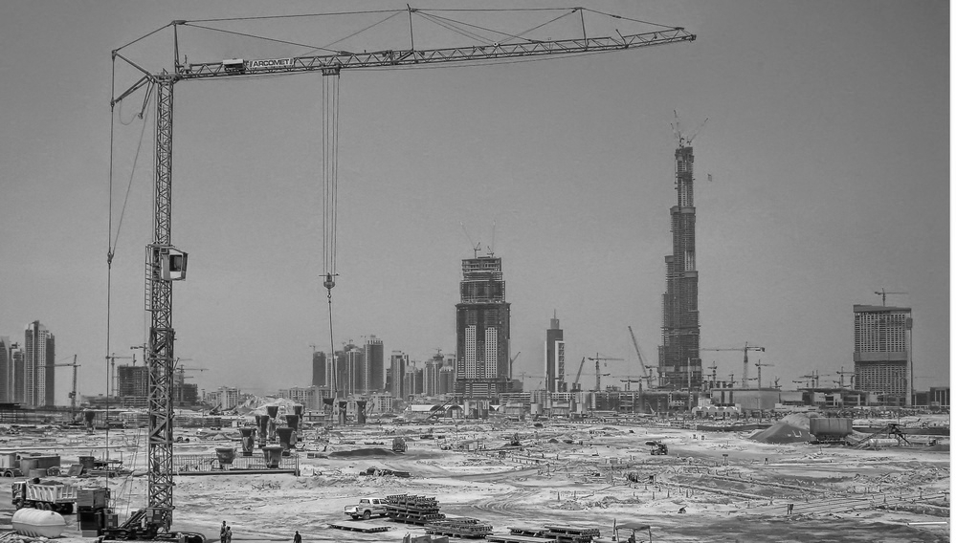
Long-Term Roll-Out
Finalize reporting requirements for new SPR program targeted for Fall 2012
IMLS will assess transition process and report back to COSLA and OMB
Systematic evaluation to be conducted after first three-years of new reporting system and at end of five-year planning cycle
http://www.flickr.com/photos/fatboyke/3177674327/sizes/l/in/photostream/

Slide 20

General Discussion
Questions about proposed content?
Continuing engagement with COSLA and SLAA staff.
http://www.flickr.com/photos/markle1/5059781862/sizes/l/in/photostream/

